Slide 1

Establishment of SNUG Developer's Working Group
An (Joseph) Vu
San Francisco VA Health Care System
Center for Imaging of Neurodegenerative Diseases

Slide 2
SNUG Developer’s Working Group
The purpose of this group is to provide a local resource for information regarding pulse sequence and reconstruction development and foster collaborations between SNUG institutions. (snug_dev@lists.berkeley.edu)
To join, email me: anvu@berkeley.edu
Your email address must be registered with a gmail account.

Slide 3
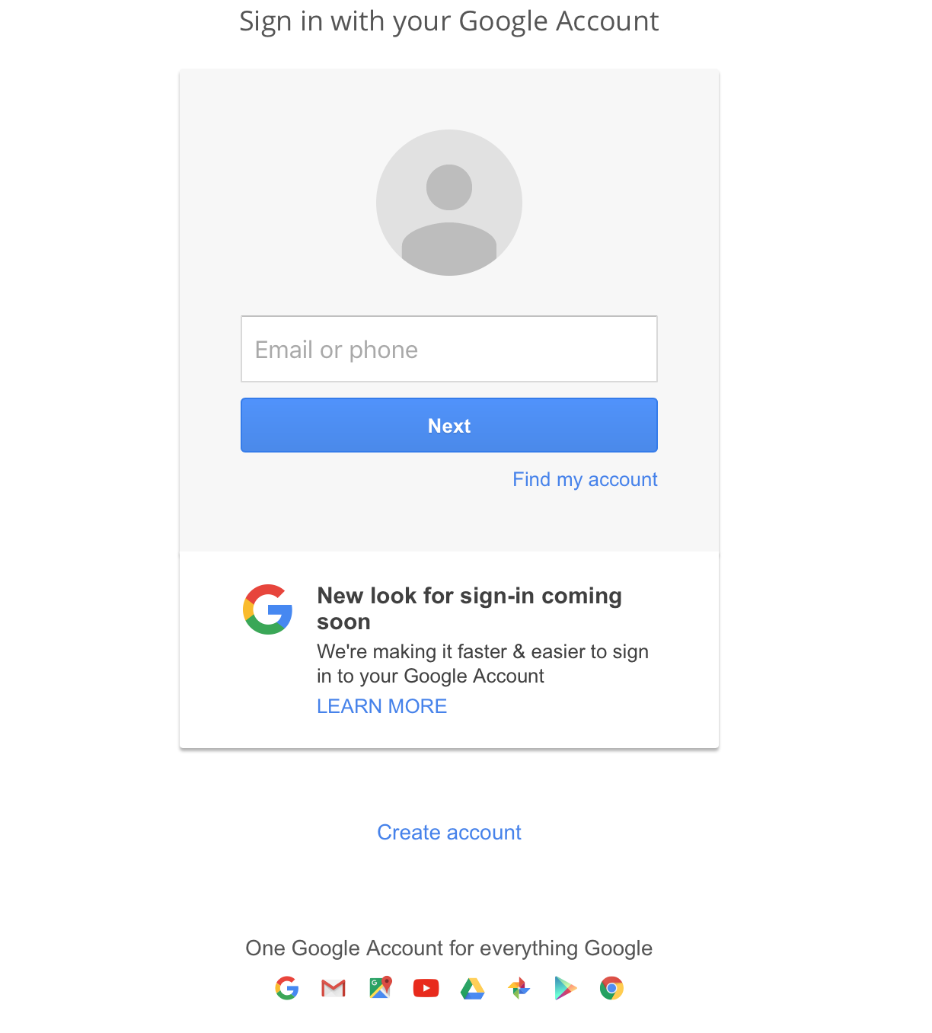
Creating a google account with non-google email address

Slide 4
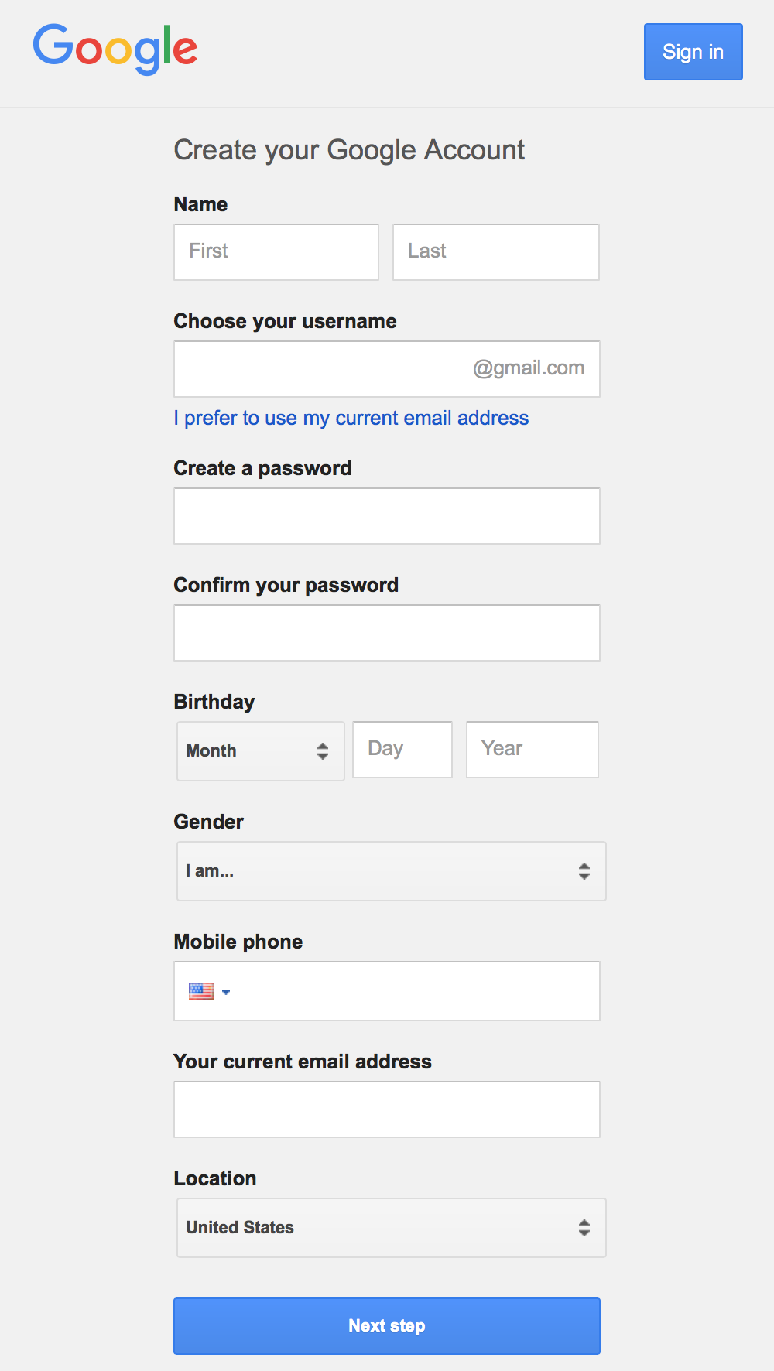
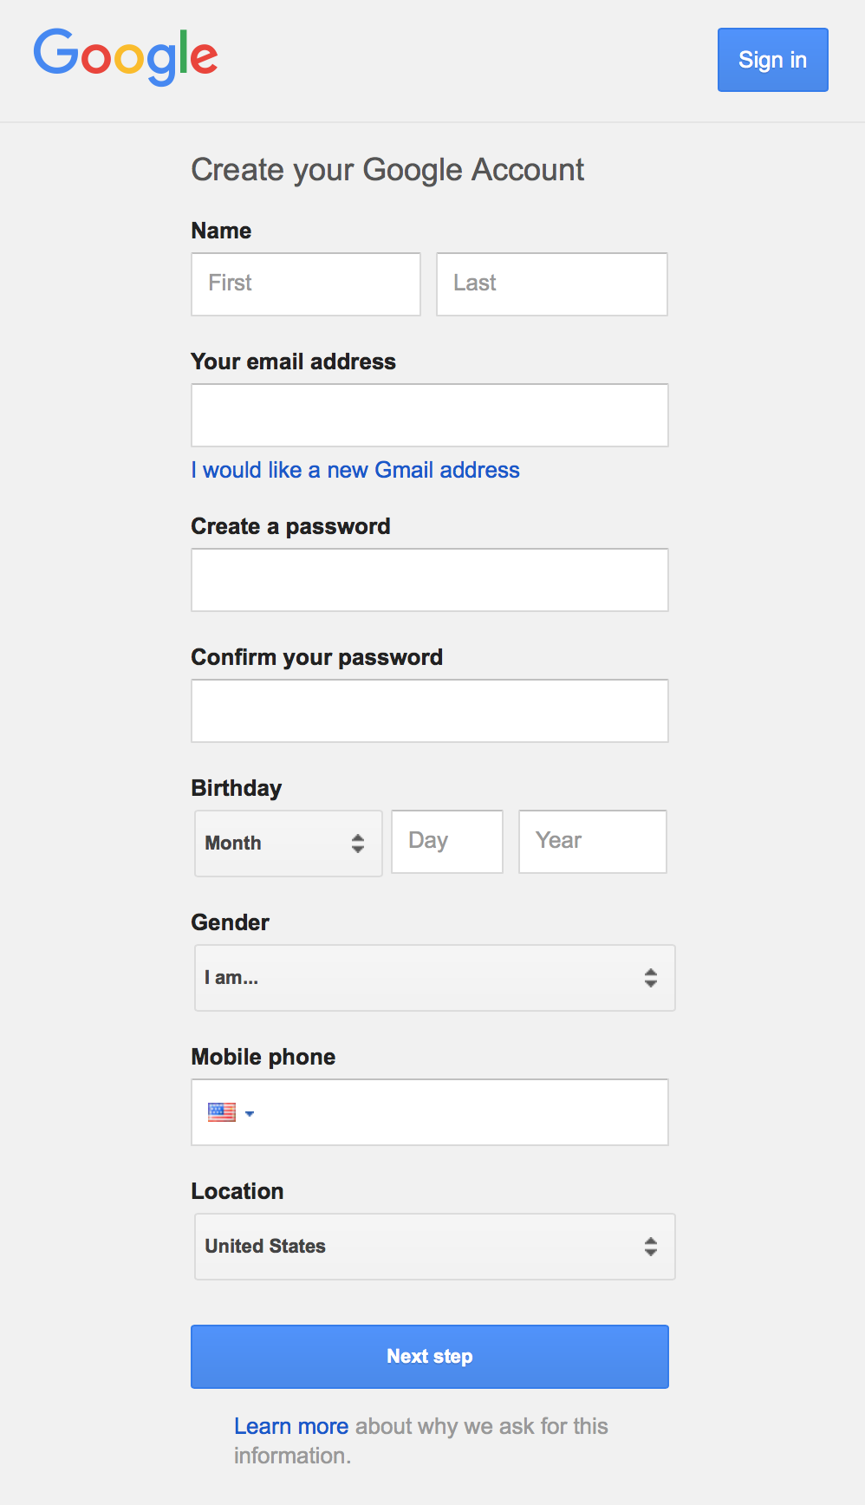

Slide 5
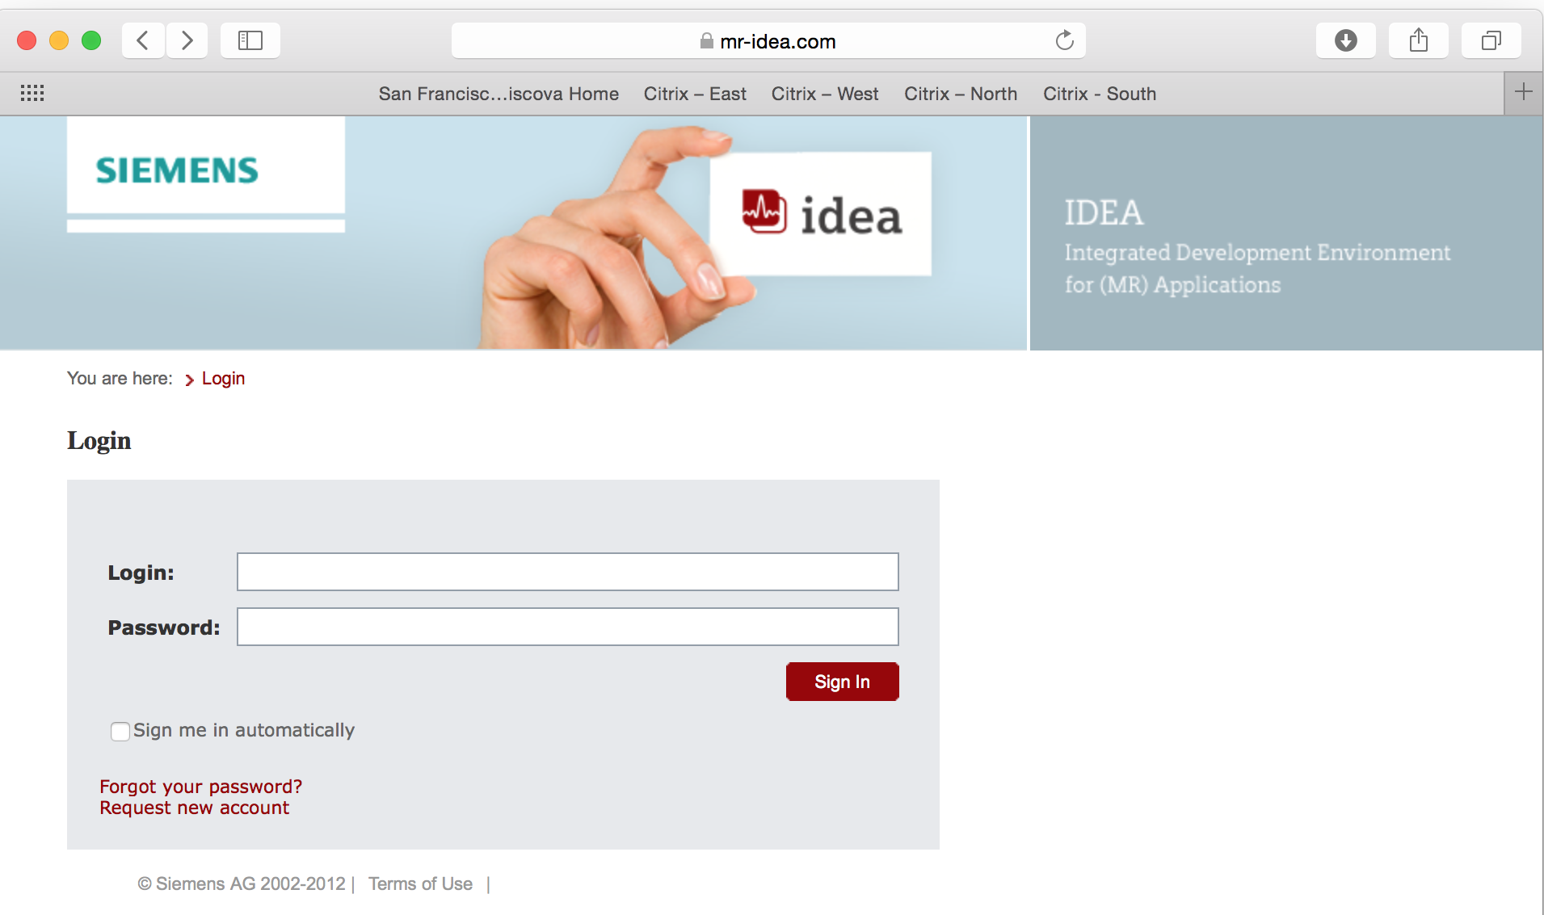
For additional resources, be sure to join the global IDEA Discussion Board

Slide 6
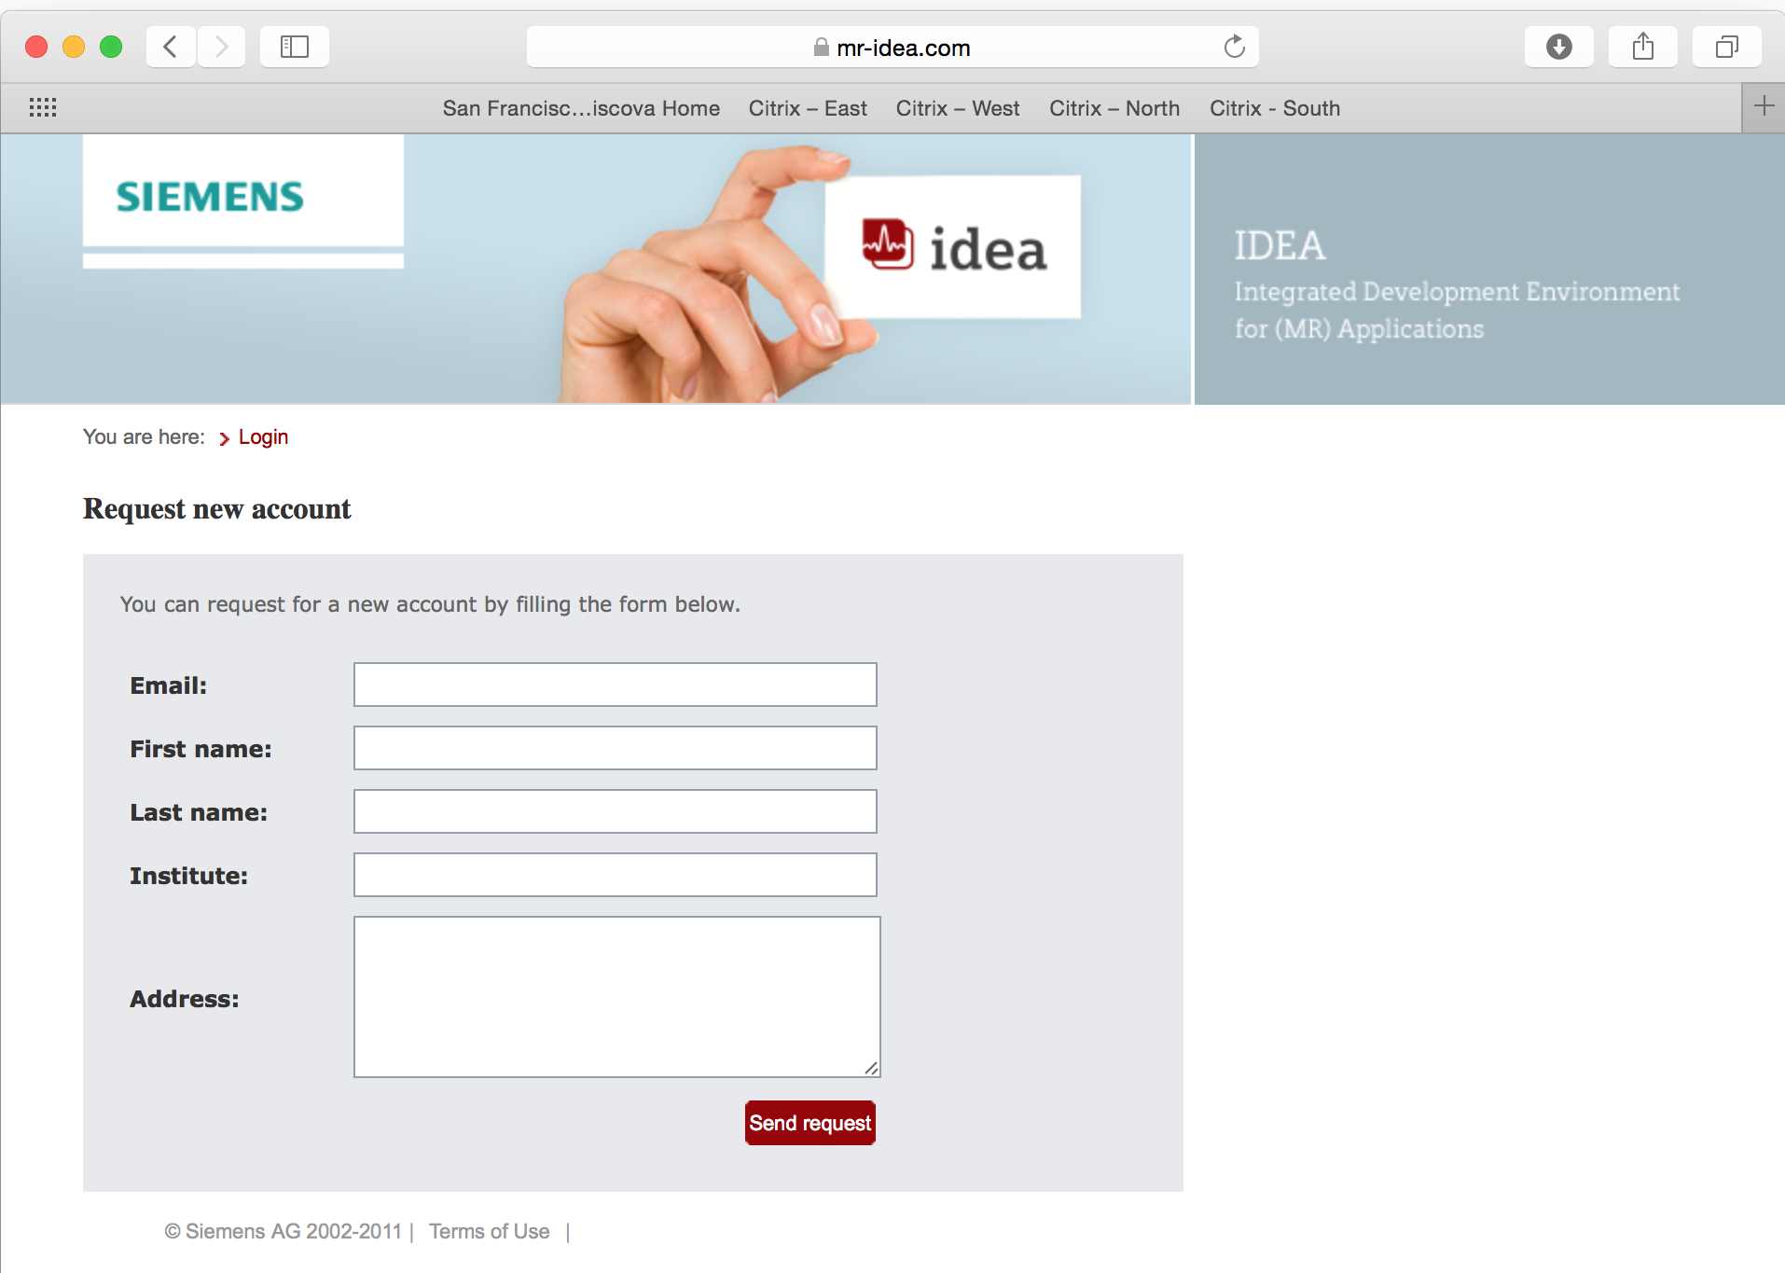

Slide 7
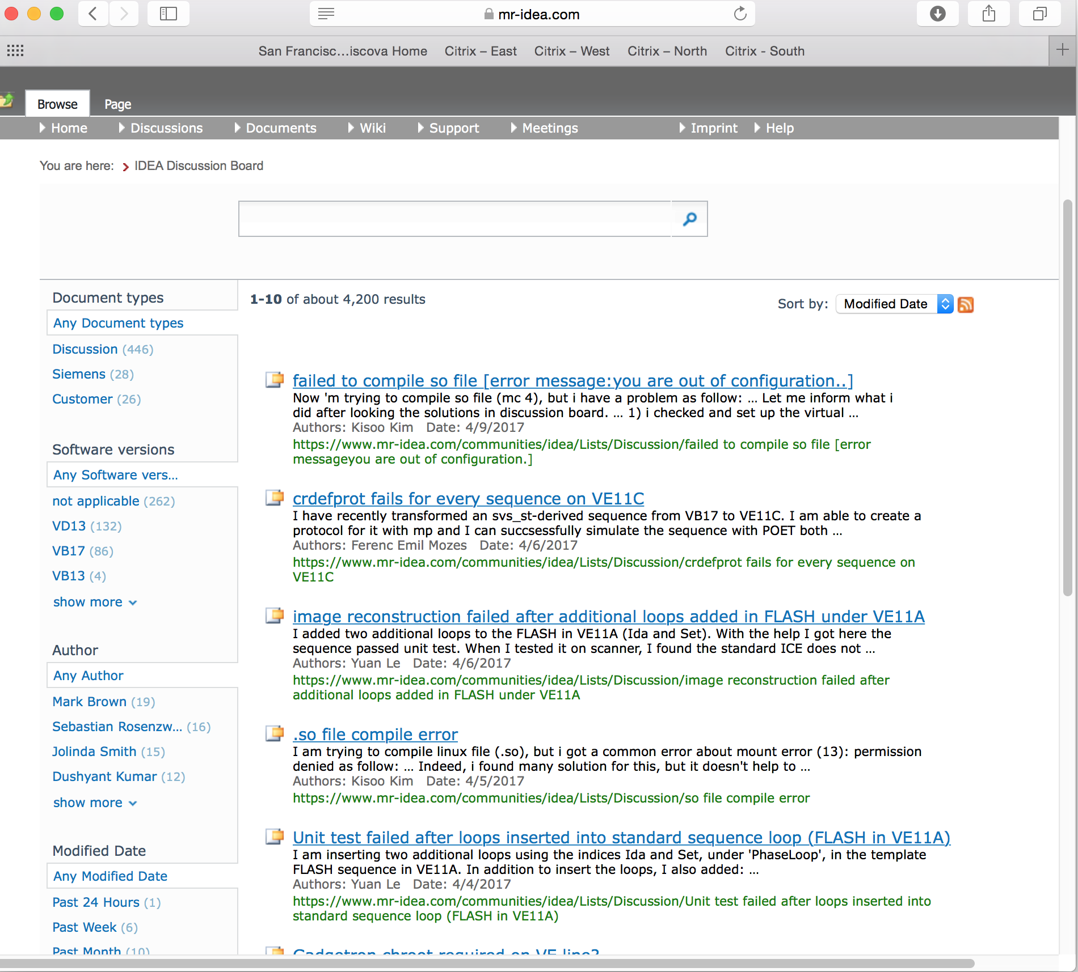

Slide 8
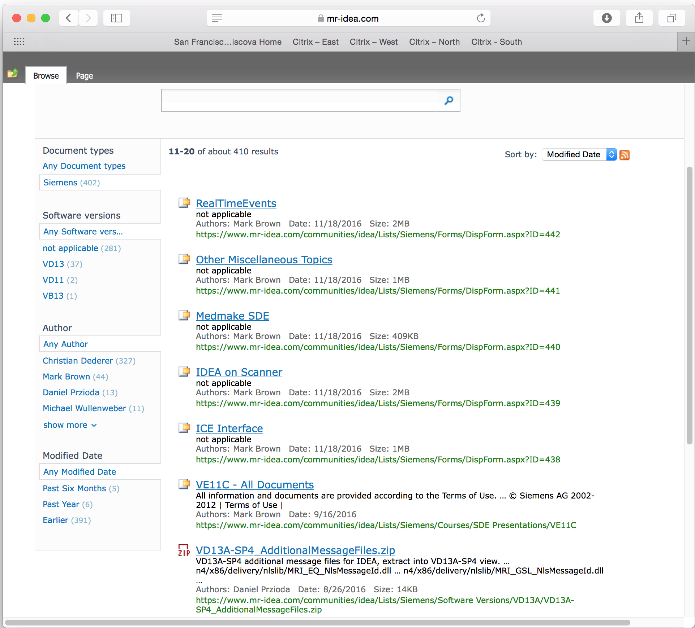

Slide 9
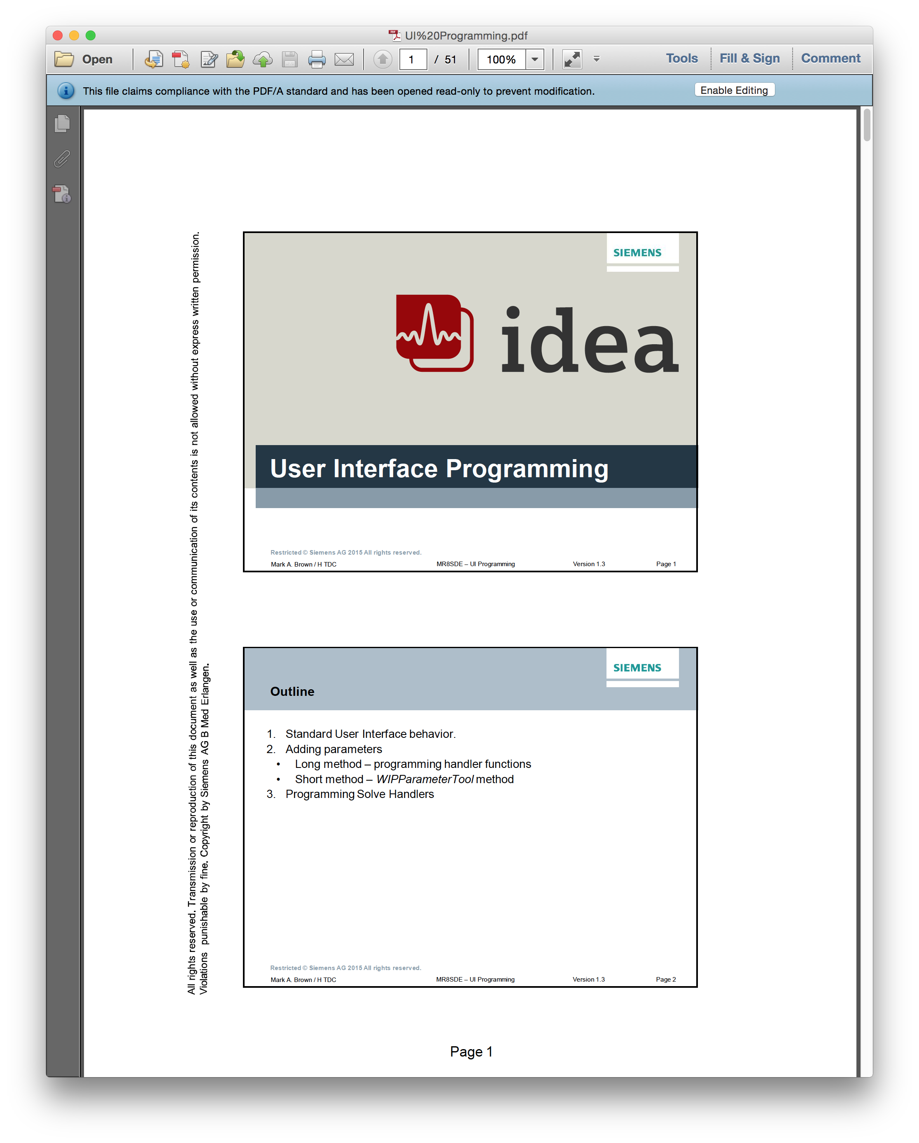
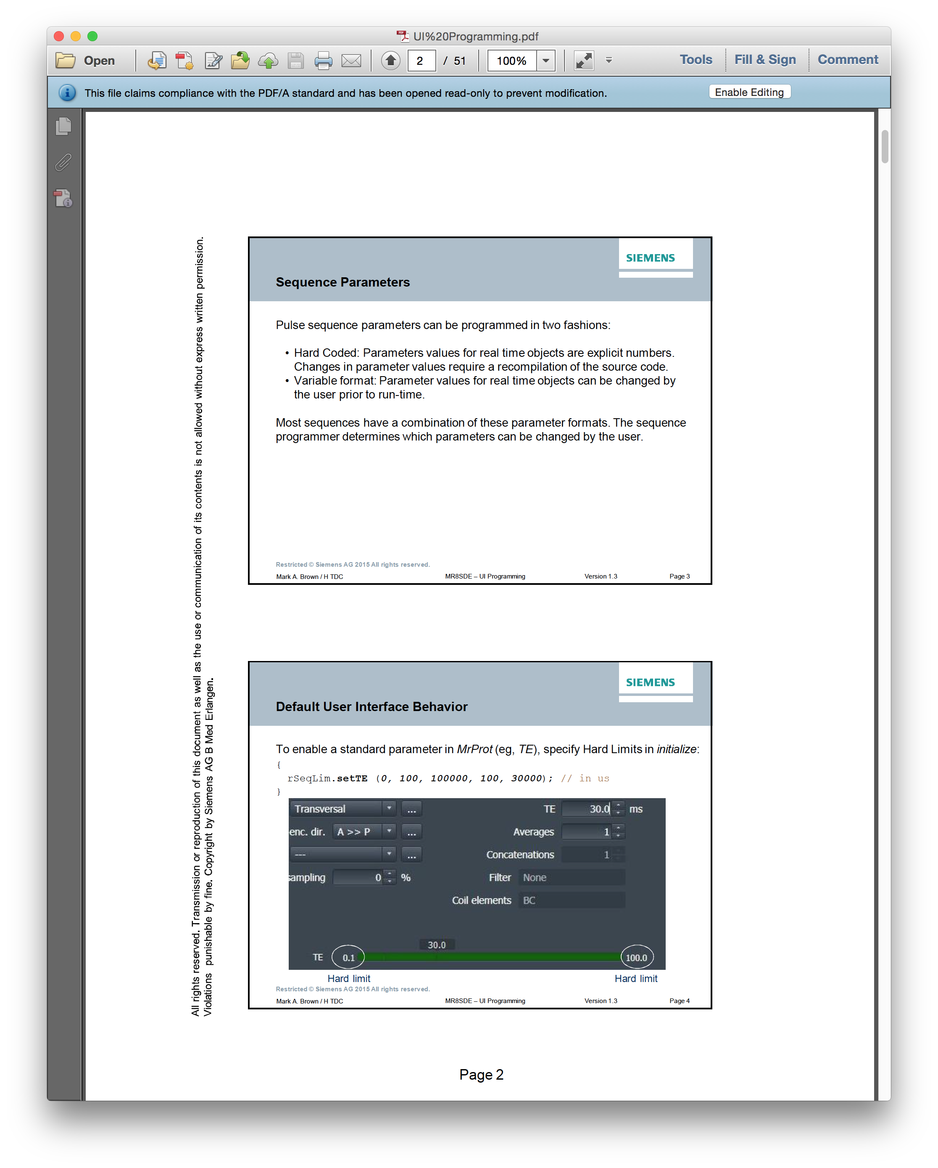

Slide 10
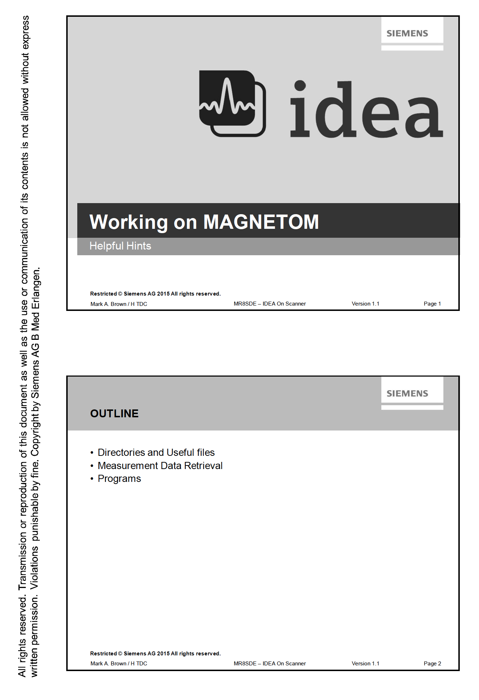

Slide 11
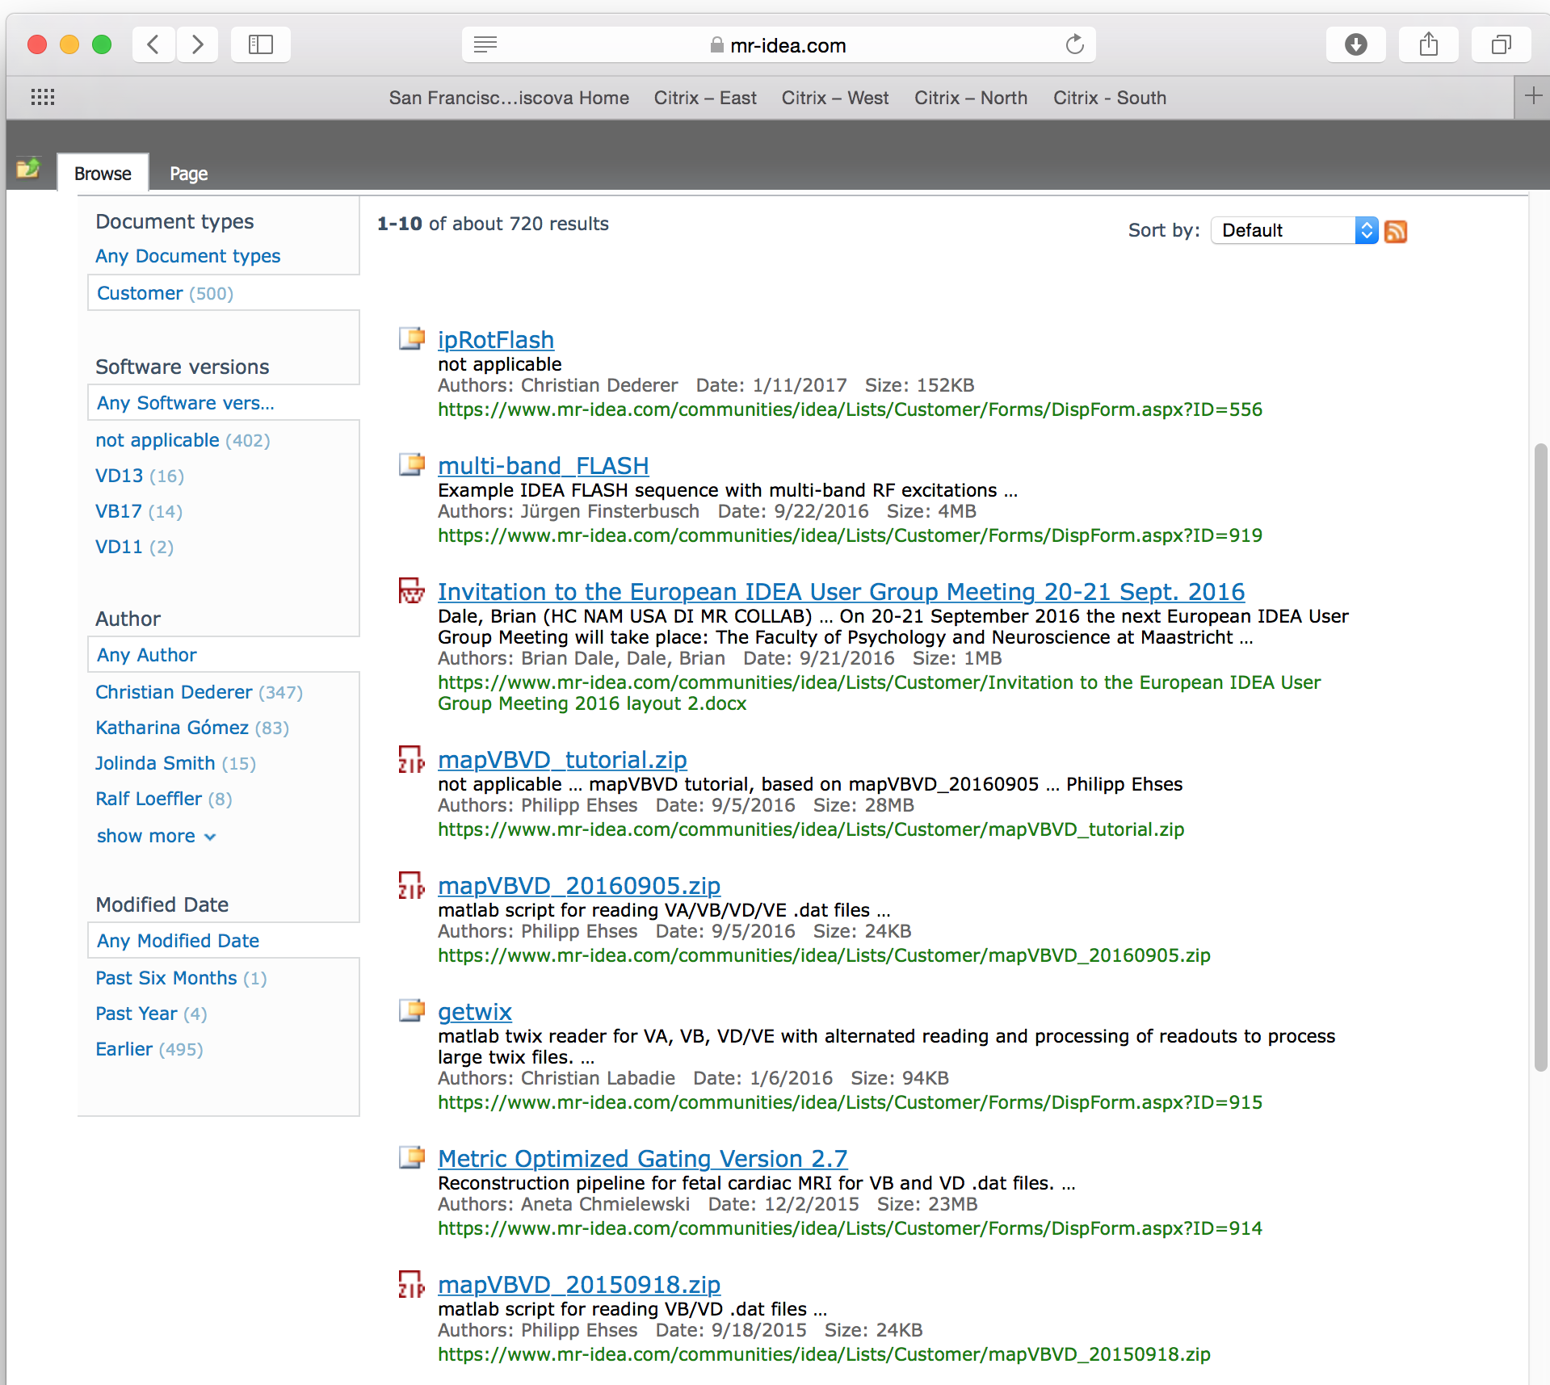

Slide 12
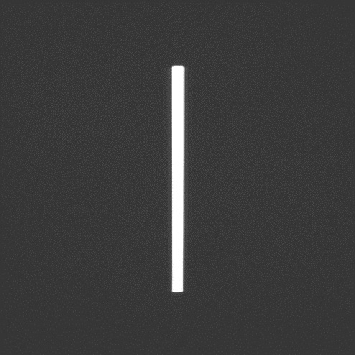
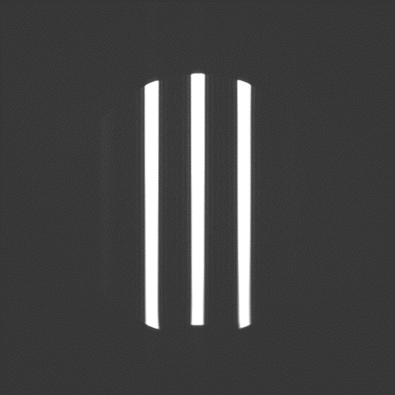
IDEA UGM Maastricht 2016
(VB17)
Jürgen Finsterbusch
Department of Systems Neuroscience
University Medical Center Hamburg-Eppendorf
Hamburg, Germany
j.finsterbusch@uke.uni-hamburg.de
A Function to Calculate Multi-Band RF Excitations
IDEA User Meeting 2016
Maastricht - 21.9.2016

Slide 13
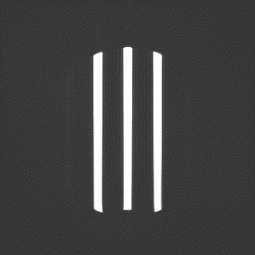
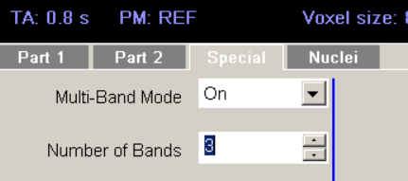
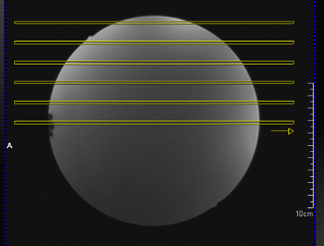
Overview
Basic Steps
user interface ‒ multi-band mode ‒ number of bands
RF pulse design ‒ combine envelopes with different phase modulations ‒ adapt flip angle calculation
pulse sequence ‒ adapt number of slices (loops, measurement time, RF energy, …)
‒ extra functionality, e.g. for CAIPIRINHA, blipped-CAIPI, etc. ‒ pass flags / parameters to ICE
reconstruction ‒ unalias ‒ adapt header information (slice position, image number, etc.)
ninPrepMultiBandRFPulse

Slide 14
Implementation
Function
determine phase modulation per unit distance
determine maximum difference
calculate samples ‒ loops and check
// loop over bands (//MB07B)
for(lcBand=lFirstBand; lcBand <= lLastBand; lcBand++) { //MB20C
// determine relevant distance (//MB07C)
double dDistance = adDistanceOfBands[lcBand];
// check phase modulation (//MB07D)
if(flMaxDiffPhase * dDistance > 2*dPi / 3) {
cout << "Sampling rate not sufficient! ABORTED!" << endl;
return false; }
// add band to multi band (//MB07D)
for(lcLoop=0;lcLoop<pRFMultiBand->getSamples();lcLoop++) {
SEE NEXT SLIDES
} // loop supp points
} // loop bands
check sampling of phase modulation, performed here to consider distances

Slide 15

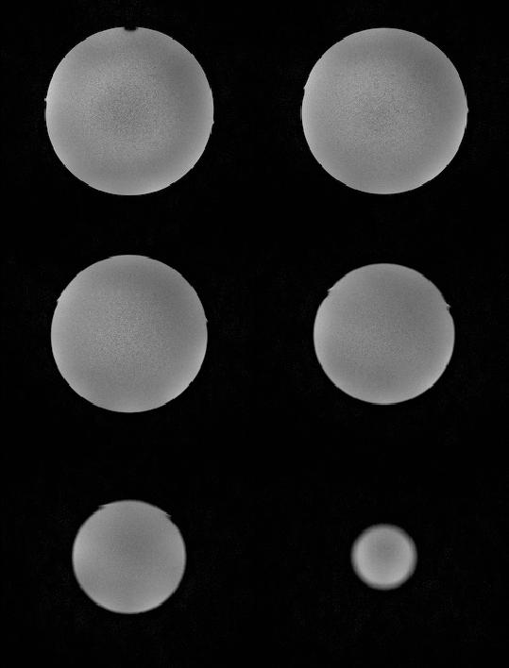

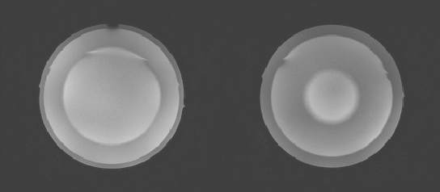
Examples
Images
single-band vs. 1 (multi-)band vs. 3 bands

Slide 16


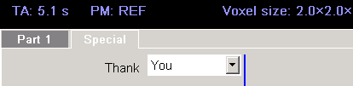
The End
Details, Questions & Feedback
j.finsterbusch@uke.uni-hamburg.de

Slide 17
What else you will need
IDEA software for your scanner
For modifying and compiling pulse sequence and reconstruction source code
Requires Master Research Agreement (MRA) between Siemens and your Institution
Source code
Requires MRA Addendum to specify scope and deliverables between Siemens and Institution

